Slide 1
Histology slides
By:ALYSSA RAYBURN

Slide 2
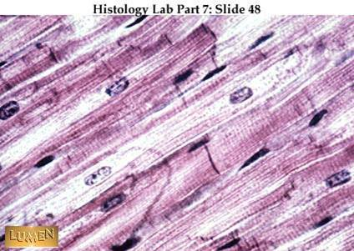
Cardiac Muscle

Slide 3
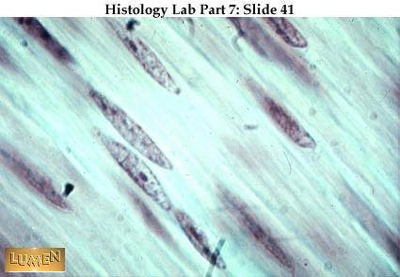
Smooth muscle

Slide 4
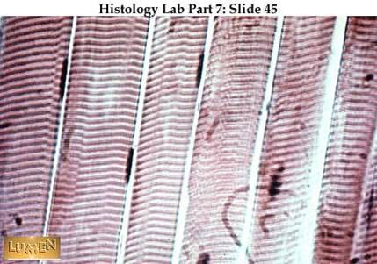
Skeletal muscle

Slide 5
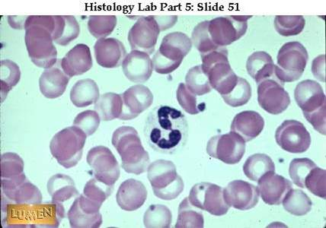
blood

Slide 6
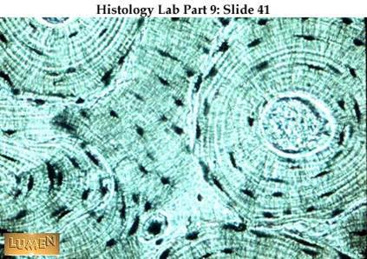
Compact bone

Slide 7
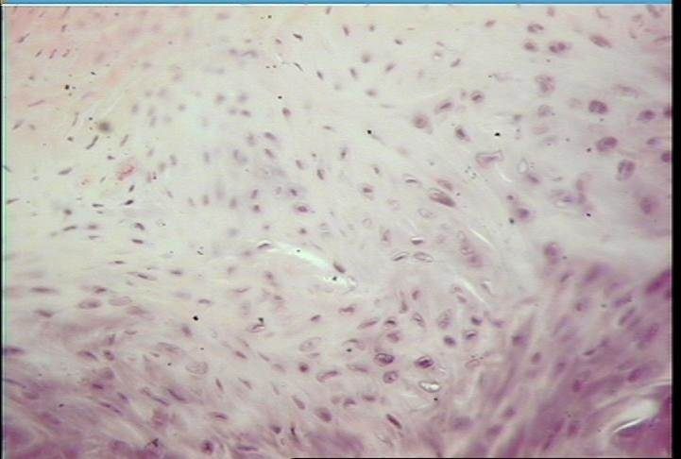
fibrocartilage

Slide 8
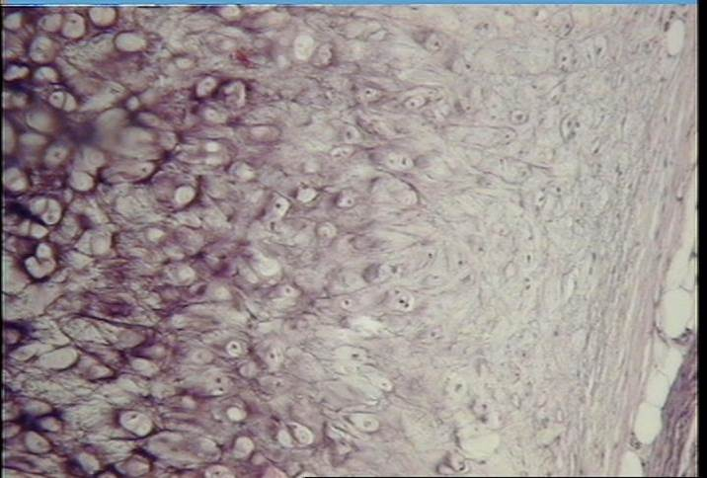
Elastic cartilage

Slide 9
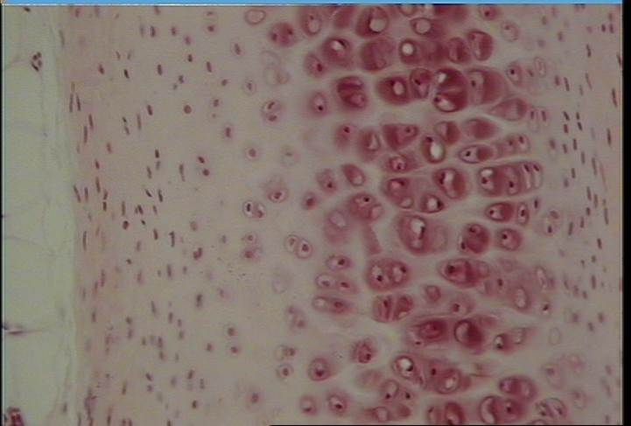
Hyaline cartilage

Slide 10
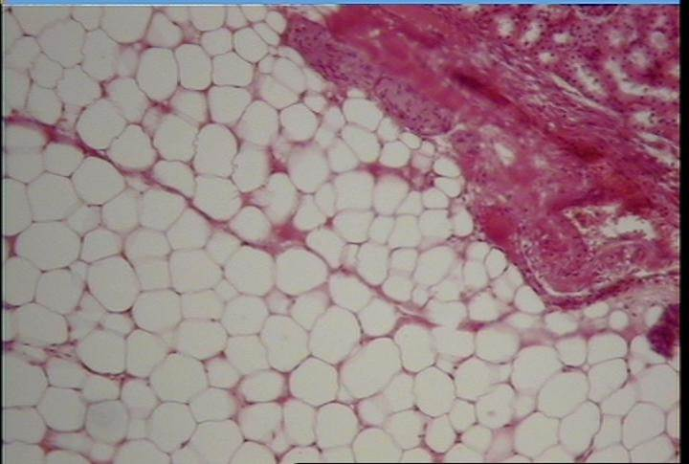
Adipose tissue

Slide 11
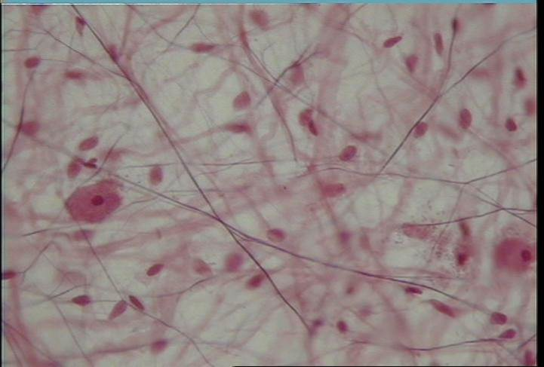
Loose connective tissue (aerolar tissue)

Slide 12
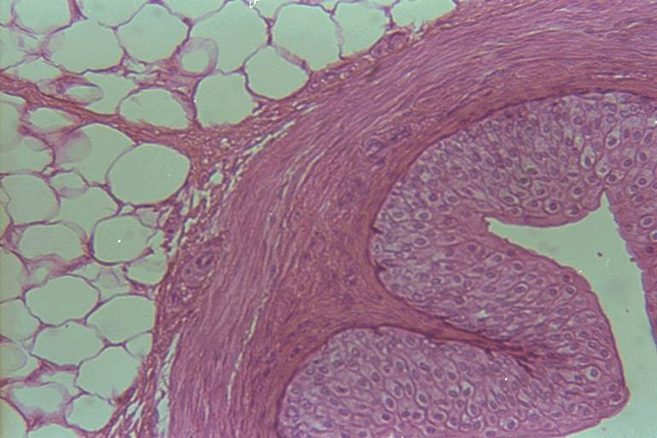
Transitional epithelium

Slide 13
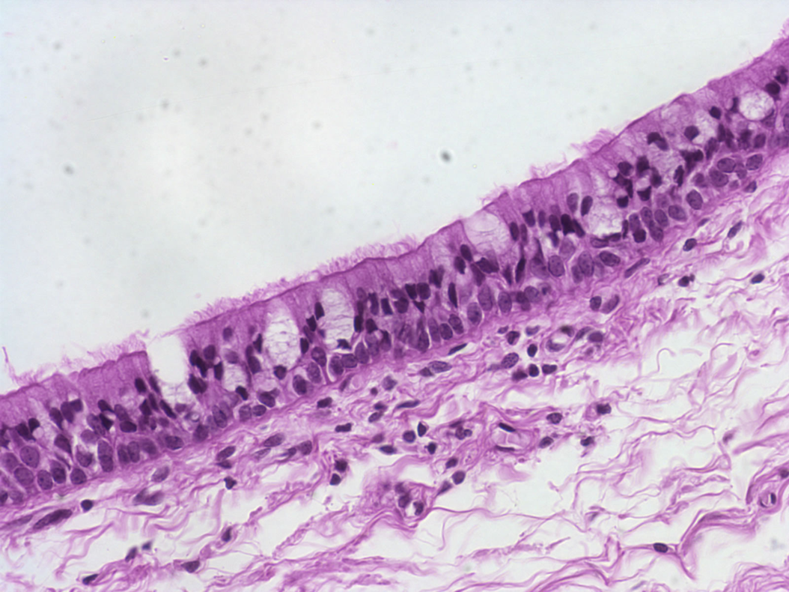
Pseudostratified columnar epithelium

Slide 14
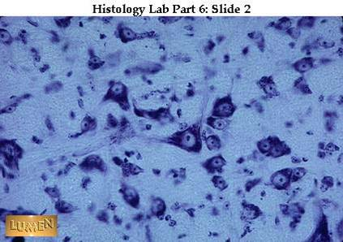
Nerve tissue

Slide 15
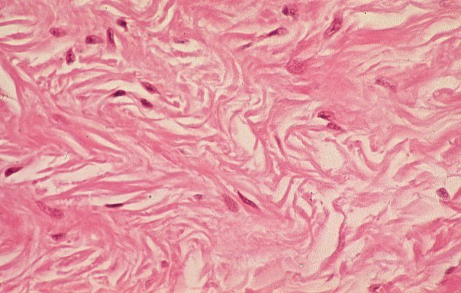
Dense irregular connective tissue

Slide 16
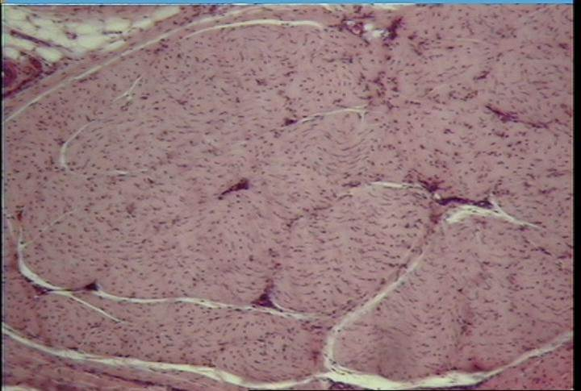
Dense regular connective tissue (cross section)

Slide 17
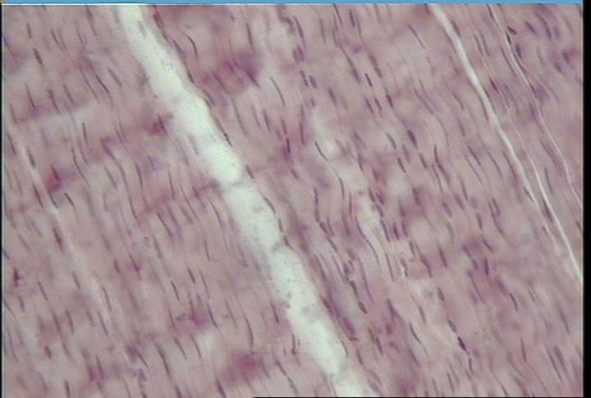
Dense regular connective tissue (longitudinal)

Slide 18
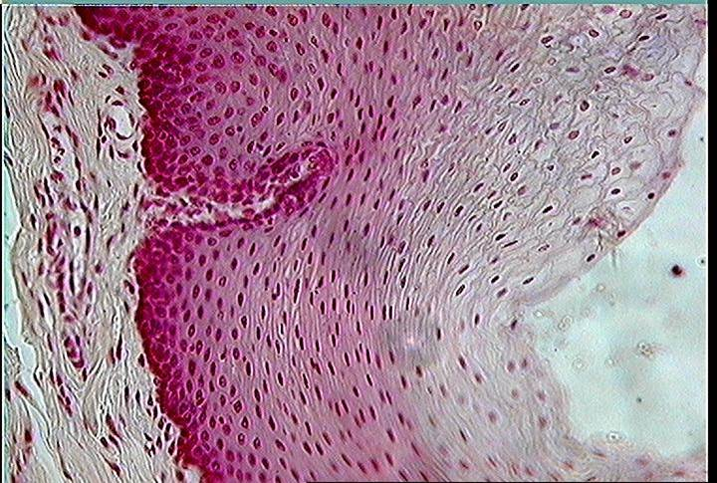
Stratified squamous epithelium

Slide 19
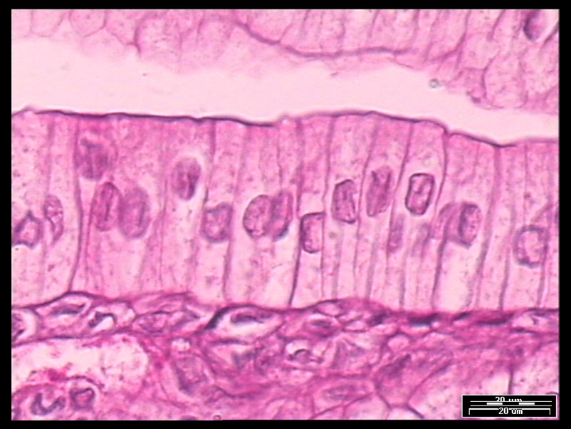
Simple columnar epithelium

Slide 20
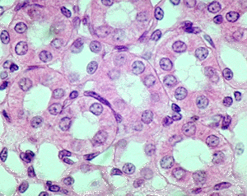
Simple cubodial epithelium

Slide 21
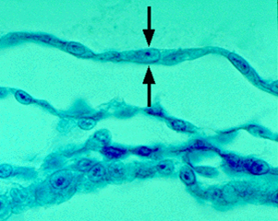
Simple squamous epithelium (cross section)

Slide 22
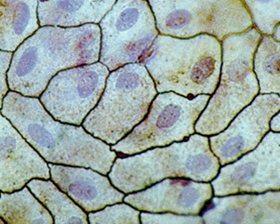
Simple squamous epithelium (top view)

Slide 23
Compact bone c.s

Slide 24
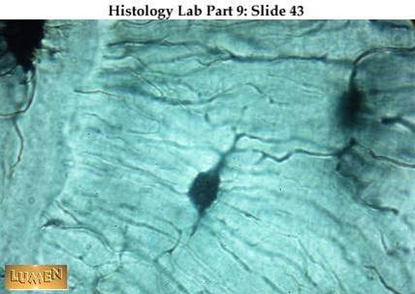
Compact bone

